Slide 1
RAG on your data with .NET, AI and Azure SQL
Davide Mauri
Principal Product Manager
Azure SQL

Slide 2
Azure SQL
Use cases
Agenda
RAG Pattern
Demo

Slide 3
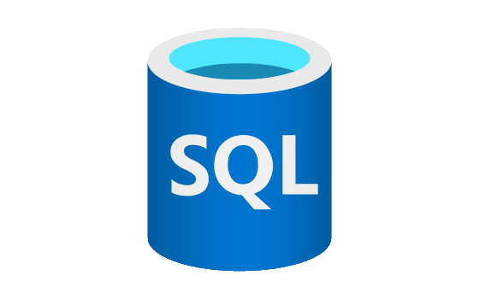
Azure SQL
The Enterprise AI Database
Modern Relational Database
True Multi-model
JSON, Graph, XML, Geospatial, Columnstore
Scalable up to 100TB, 80v-Cores, 30 replicas
Support for Vector in Early Adopter Preview
https://aka.ms/azuresql-vector-eap-announcement
Enterprise-grade security & audit features
Integration with common Azure Services
Azure Functions, Static Web Apps
Integration with most loved libraries
.NET EF Core, .NET Aspire, LangChain, Semantic Kernel, etc.

Slide 4
AI+SQL Use Cases
The Enterprise AI Database
Hybrid search: vector (semantic) search + full-text search + filters
E.g.: “Find all the documents from Acme customer written by John Doe that are related to the new security policies“
Chatbot memories
Retrieval Augmented Generation

Slide 5
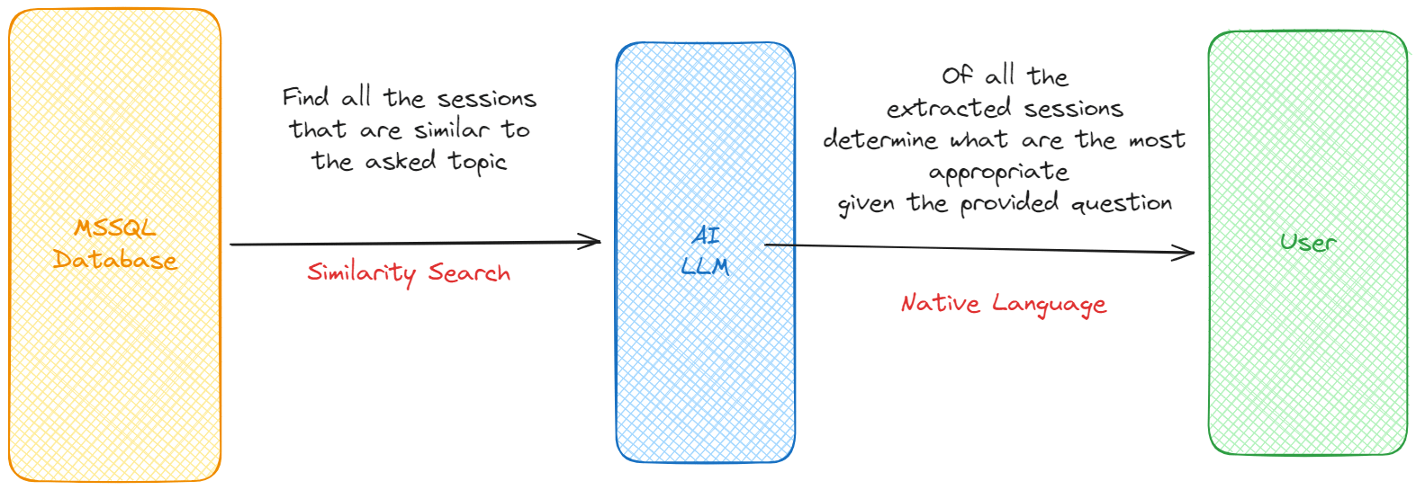


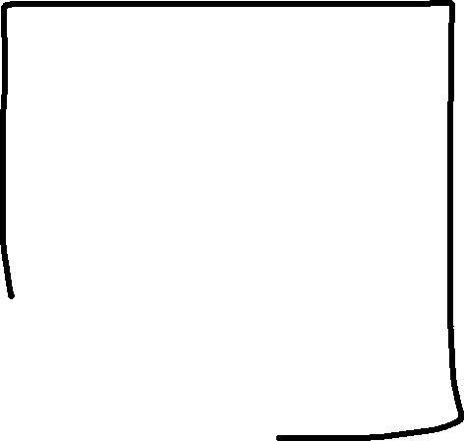
Retrieval Augmented Generation
Prompt Engineering

Slide 6
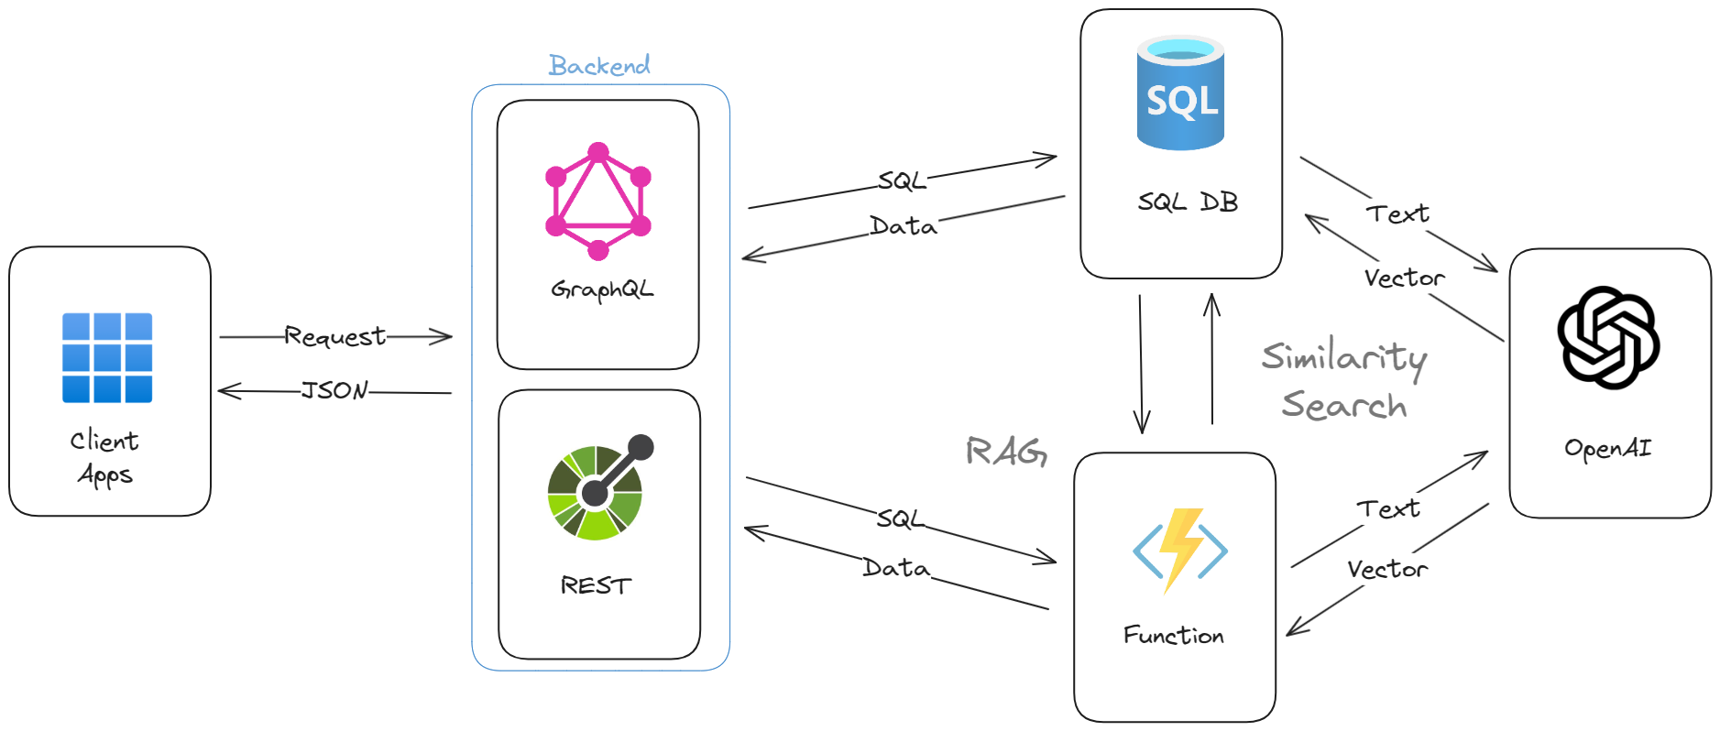
High-Level Architecture

Slide 7
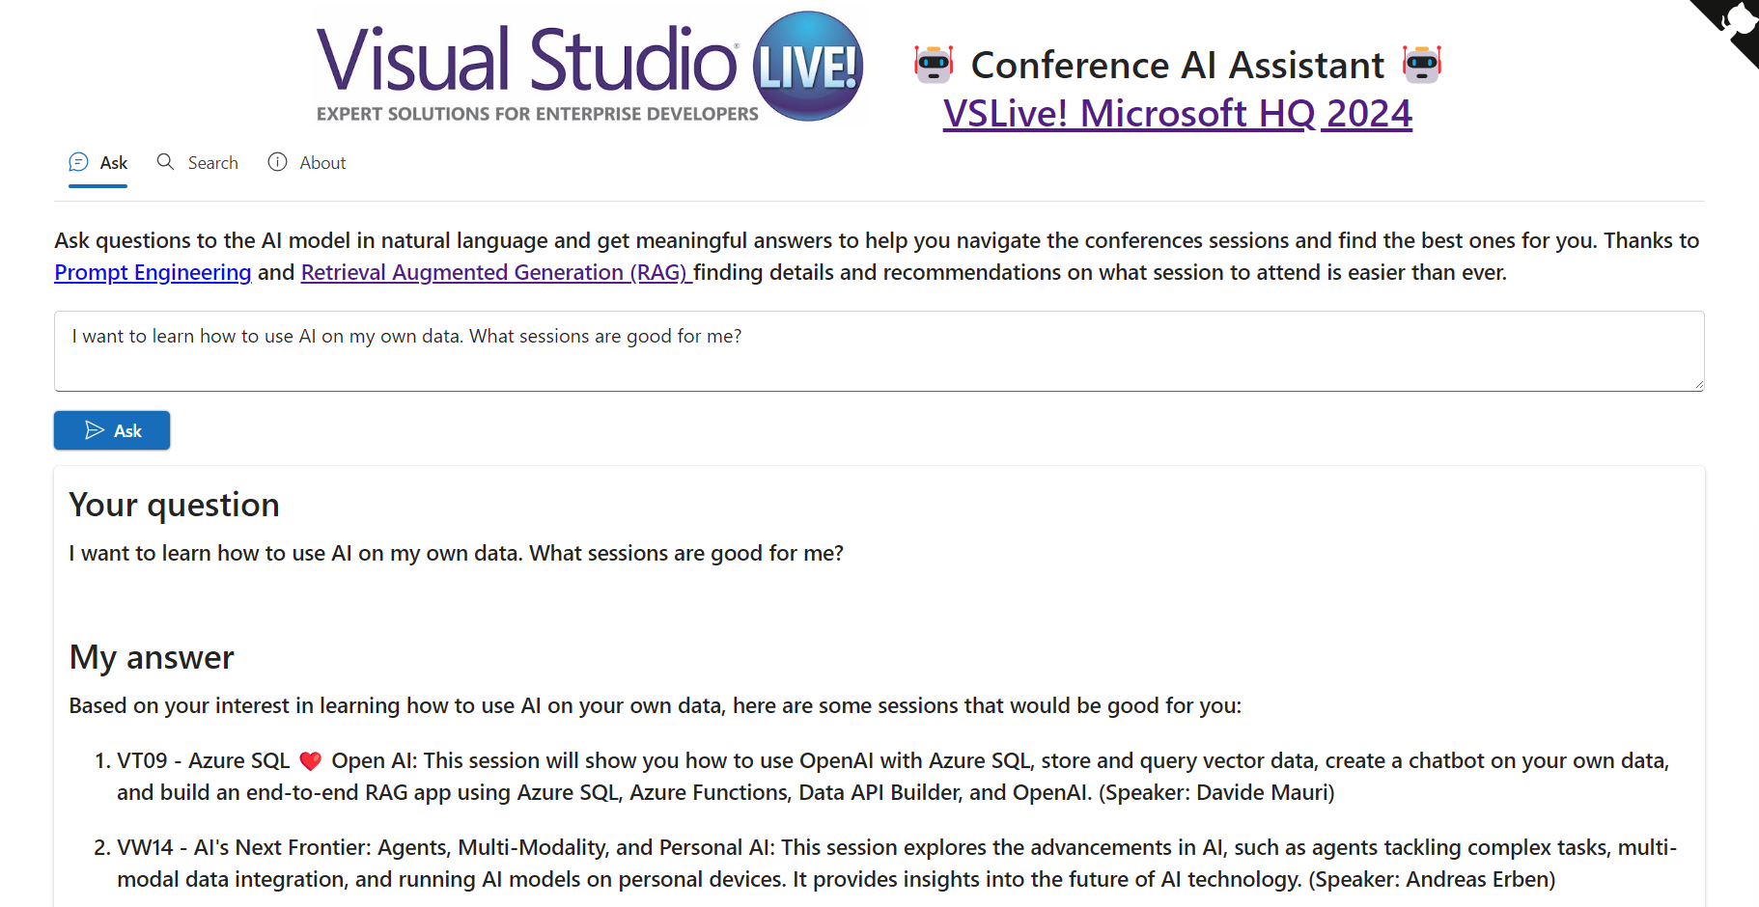
https://ai.microsofthq.vslive.com/

Slide 8
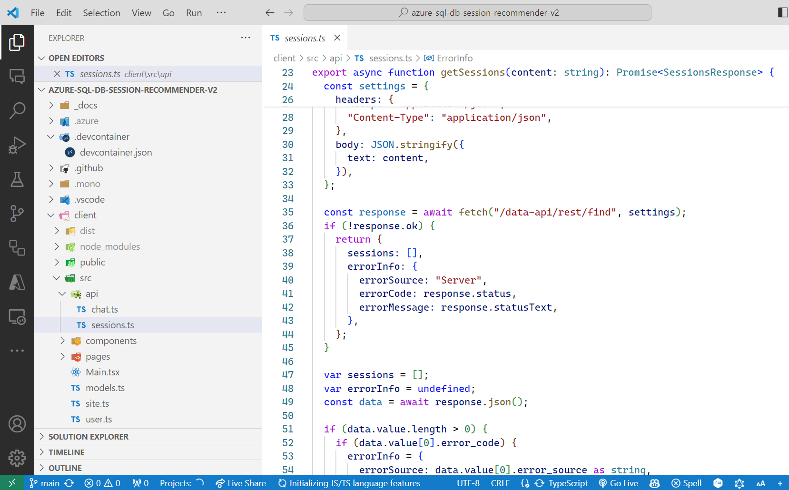
Build a Conference AI Assistant
RAG Pattern

